Slide 2
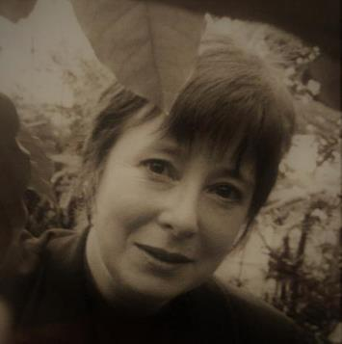
What is The Lorna Young Foundation?
Enabling farming communities to access and share the information and knowledge they need to succeed
Training through radio, SMS and FFS
More sustainable farming practices
Great resilience to climate change
Improved trading relationships
Capacity building of local institutions
Notes:
The LYF is a UK NGO. We were established in 2003 and named after the Scottish fair trade pioneer- Lorna Young, who sadly passed away in the nineties.
Our aim is to enable farming communities to access and share the information and knowledge they need to succeed so much of our work focuses on improved access to information, more sustainable farming practices and better trading relationships for smallholder farmers
Our training has been delivered through radio, SMS, farmer field schools and stakeholder platforms and we build the capacity of local institutions to run farmer training and information services, tailored to the needs of smallholders. Over the last 11 years our work has really focussed on the use of participatory radio to connect with and empower smallholder farming communities- and this initiative is called Farmers’ Voice Radio.

Slide 3
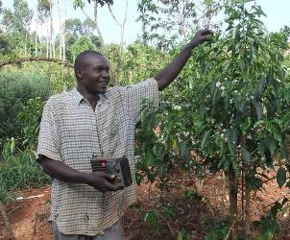
FARMERS’ VOICE RADIO: A DIFFERENT WAY OF SUPPORTING COFFEE FARMERS
Remote rural communities across the world are under huge pressure
Intensive cultivation, climate change and degraded land are making traditional livelihoods unviable
Poor infrastructure, low education levels and social exclusion (particularly women) prevent access to essential information and services
COVID 19 has disrupted markets and face-to-face service delivery, causing further isolation
Radio overcomes these barriers: it is accessible, affordable, trusted, inclusive and quickly reaches thousands!
Notes:
Farmers’ Voice Radio takes a traditional technology, radio, and uses it in a unique way that enables farming communities to pool their own knowledge with that of agricultural experts and supply chain partners and draw attention to their needs and challenges. Farmers Voice Radio provides an innovative solution to the complex needs faced by smallholder coffee producers.
As highlighted in the slide, the challenges faced by smallholder coffee producers are:
Intensive cultivation, climate change and degraded land are making traditional livelihoods unviable
Poor infrastructure, low education levels and social exclusion (particularly women) prevent access to essential information and services
COVID 19 has disrupted markets and face-to-face service delivery, causing further isolation
LYF has always been about facilitating peer-to-peer knowledge exchange, recognising that farmers themselves have generations of experience of what works and what doesn’t but often lack the means and opportunity to pool these knowledge resources and apply them to new challenges, such as climate change and shifting market interests. In addition, many groups of farmers have historically been excluded from more mainstream agricultural extension activities, such as farmer field schools etc- due to physical, cultural and educational access barriers, such as those living in very remote communities, women, people with disabilities and those with low literacy.
Radio overcomes many of the obstacles farmers can experience in accessing mainstream agricultural extension interventions, such as low literacy, poor infrastructure and traditional gender roles. It is trusted, inclusive and has a wide and rapid reach. Despite the growth of mobile phone connectivity across the world, FM radio is still the most affordable and accessible communications medium in lower income countries. Radio is particularly effective at reaching women- who can listen at home or at work in the fields (the most basic nokia mobile handsets that people have across rural Africa- pick up FM radio and you often see women working in the fields with their phone tucked into their headscarf!). As you can imagine, radio has also been particularly vital in communicating and connecting with rural communities during the COVID lockdowns and travel restrictions.

Slide 4
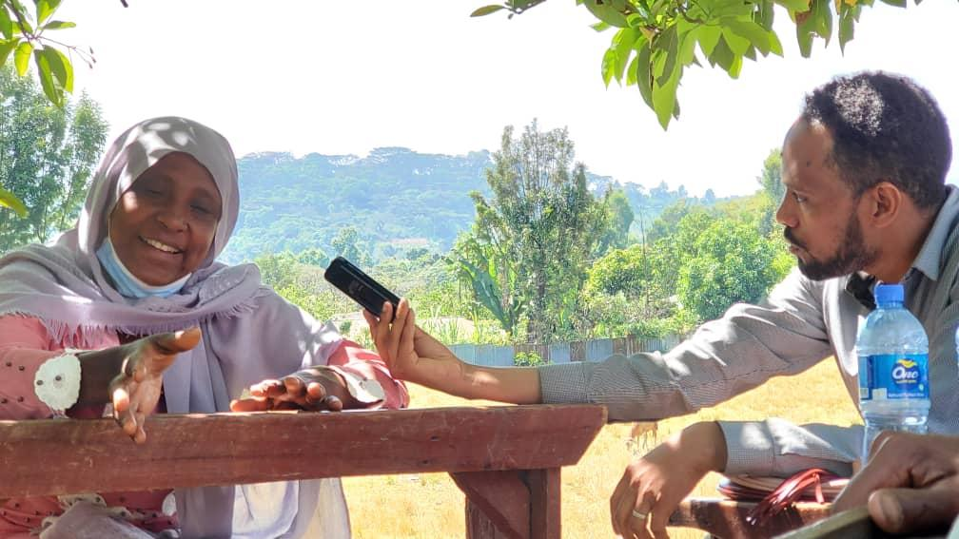
Farmers’ Voice Radio enables farming communities to access and share the information they need to succeed. It is proven to:
strengthen smallholder supply chains
increase crop yields and quality
improve smallholder access to markets
enhance women’s participation
build climate change resilience
Coffee producer being interviewed for a Farmers’ Voice Radio programme, Jimma, Ethiopia
Notes:
Farmers’ Voice Radio enables farming communities to access and share the information they need to succeed. And it is proven to:
strengthen smallholder supply chains
increase crop yields and quality
improve smallholder access to markets
enhance women’s participation
build climate change resilience
This is a picture from Oromia- from the coffee radio programmes broadcasting from Jimma. I will tell you more about this shortly.

Slide 5
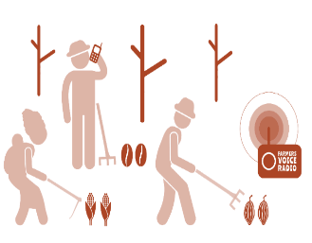
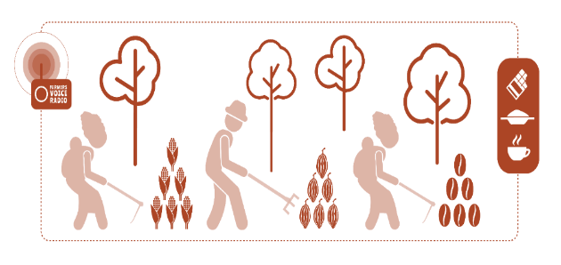
HOW DOES FARMERS’ VOICE RADIO WORK?
Farmers' Voice Radio brings smallholder farmers together with other relevant experts in community settings to discuss their challenges on the radio.
These discussions are broadcast to hundreds of thousands more farmers in local languages. Listeners can contribute to the conversation and ask questions, increasing participation and creating a dialogue.
Other stakeholders provide technical input and answer listener questions. The conversation continues off-air, building stronger connections between farmers, businesses, governments and consumers, and growing sustainable rural communities.
Notes:
The Lorna Young Foundation first used radio in a project in Kenya that was focussed on strengthening the resilience to climate change of coffee producers in the Nyeri region. We have further developed, formalized and branded the methodology that you can see on the screen here. FVR centres around a group of farmers, such as a group of men and women coffee producers, who form a Programme Reference Group. This group comes together to discuss their challenges and solutions on the radio. The discussions are aired on local community radio in local language- and listeners are invited to call in and contribute their thoughts and questions. These questions are answered by local experts and stakeholders- building connections between farmers and increasing transparency in the supply chain.

Slide 6
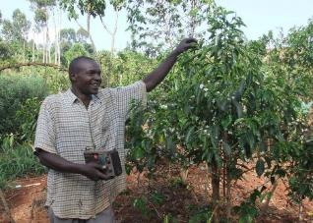
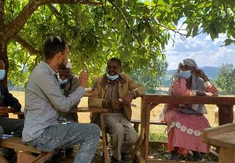
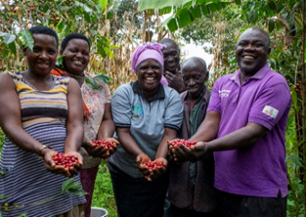
Nyeri, Kenya
Oromia, Ethiopia
Mt Elgon, Uganda
500,000 people reached
10,000 disease resistant coffee seedlings planted
705 coffee farmers joined cooperative (50% of which were women)
100,000 people reached
Improved knowledge and practice on good agricultural practices & children's rights
Increased coffee quality and environmental standards
250,000 people reached
Improved knowledge, attitudes and practices for sustainable coffee production
Cooperative gained 221 new members & 2 new primary societies
Notes:
Farmers Voice Radio projects have been implemented in 9 countries with coffee, cocoa, tea and shea producers and non-commodity crops and we have delivered projects focused on coffee producers in Uganda, Ethiopia and more recently in Panama. Here are some of the results…
In Kenya, we know that over half a million coffee producers reached- but the actual numbers of listeners were far higher as the programmes were aired on a main Swahili radio station. The coffee exporter Dormans Coffee was a partner in this project. Other supply chain actors are often partners in our projects (for example we are also working with The Body Shop in a shea butter project and Twinings Tea in a new tea project in Kenya) - for businesses like these, involvement in a FVR project strengthens their communication with suppliers and enhance supply chain transparency, bringing producers closer to the end consumer - something that has been particularly challenging over the last two years due to the COVID-19 lockdowns.
This project in Ethiopia is still ongoing, with the Oromia Coffee Farmers Cooperative Union. The recent midterm review was extremely positive- with reported changes in practices such as composting, seed selection and a decrease in children helping in the last harvest. Women particularly reported back very positively about how the radio programmes were presented.
The Mount Elgon project in Uganda came to an end a few months ago. This project was developed in partnership with Rainforest Alliance. The evaluation showed improvements to coffee cherry fermentation and drying, and adoption of practices including stumping, soil erosion control and organic growing. The programmes also empowered women farmers in the region- and many reported greater control over coffee income.

Slide 7
Esther and Agnes, coffee farmers and Programme Reference Group members
Notes:
But don’t just take it from me… Here is Ester and Agnes, a Programme Reference Group member and a listener from the Mt Elgon coffee region talking about the impact of the radio programmes on their lives.

Slide 8
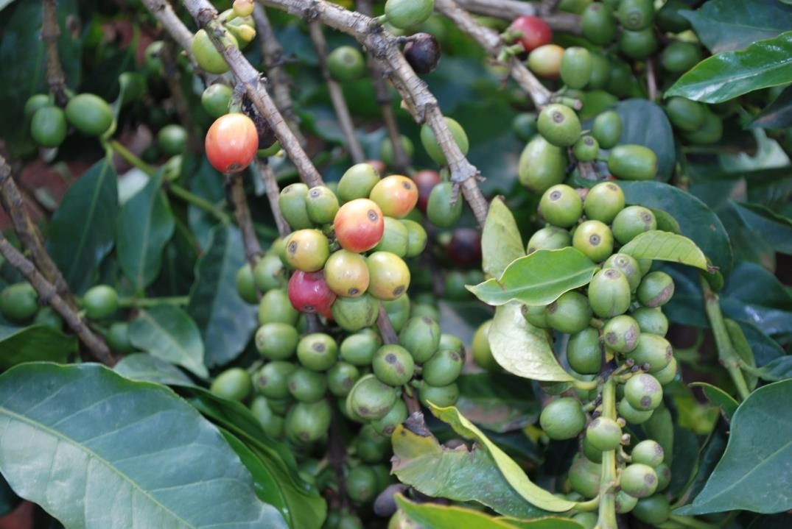
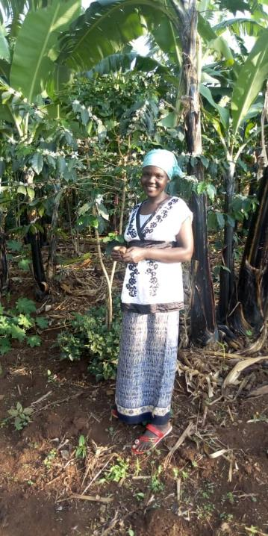
Esther Chelangat, MEACCE farmer and Listener Group member:
”[Farmers’ Voice Radio] has enabled me become more knowledgeable and made me responsible for others to learn from. That is why I take the group discussions and listening to the radio very [seriously] because as a listener group member I am supposed to pass on the information to other community members. We need to be more informed so that we teach others and when they ask us, we are able to answer.”
Click here to hear more from Esther about her Farmers’ Voice Radio experience
Notes:
Only use if the video doesn’t work. Read the quote out from Esther Chelangat, MEACCE farmer and Listener Group member:
”[Farmers’ Voice Radio] has enabled me become more knowledgeable and made me responsible for others to learn from. That is why I take the group discussions and listening to the radio very [seriously] because as a listener group member I am supposed to pass on the information to other community members. We need to be more informed so that we teach others and when they ask us, we are able to answer.”

Slide 9
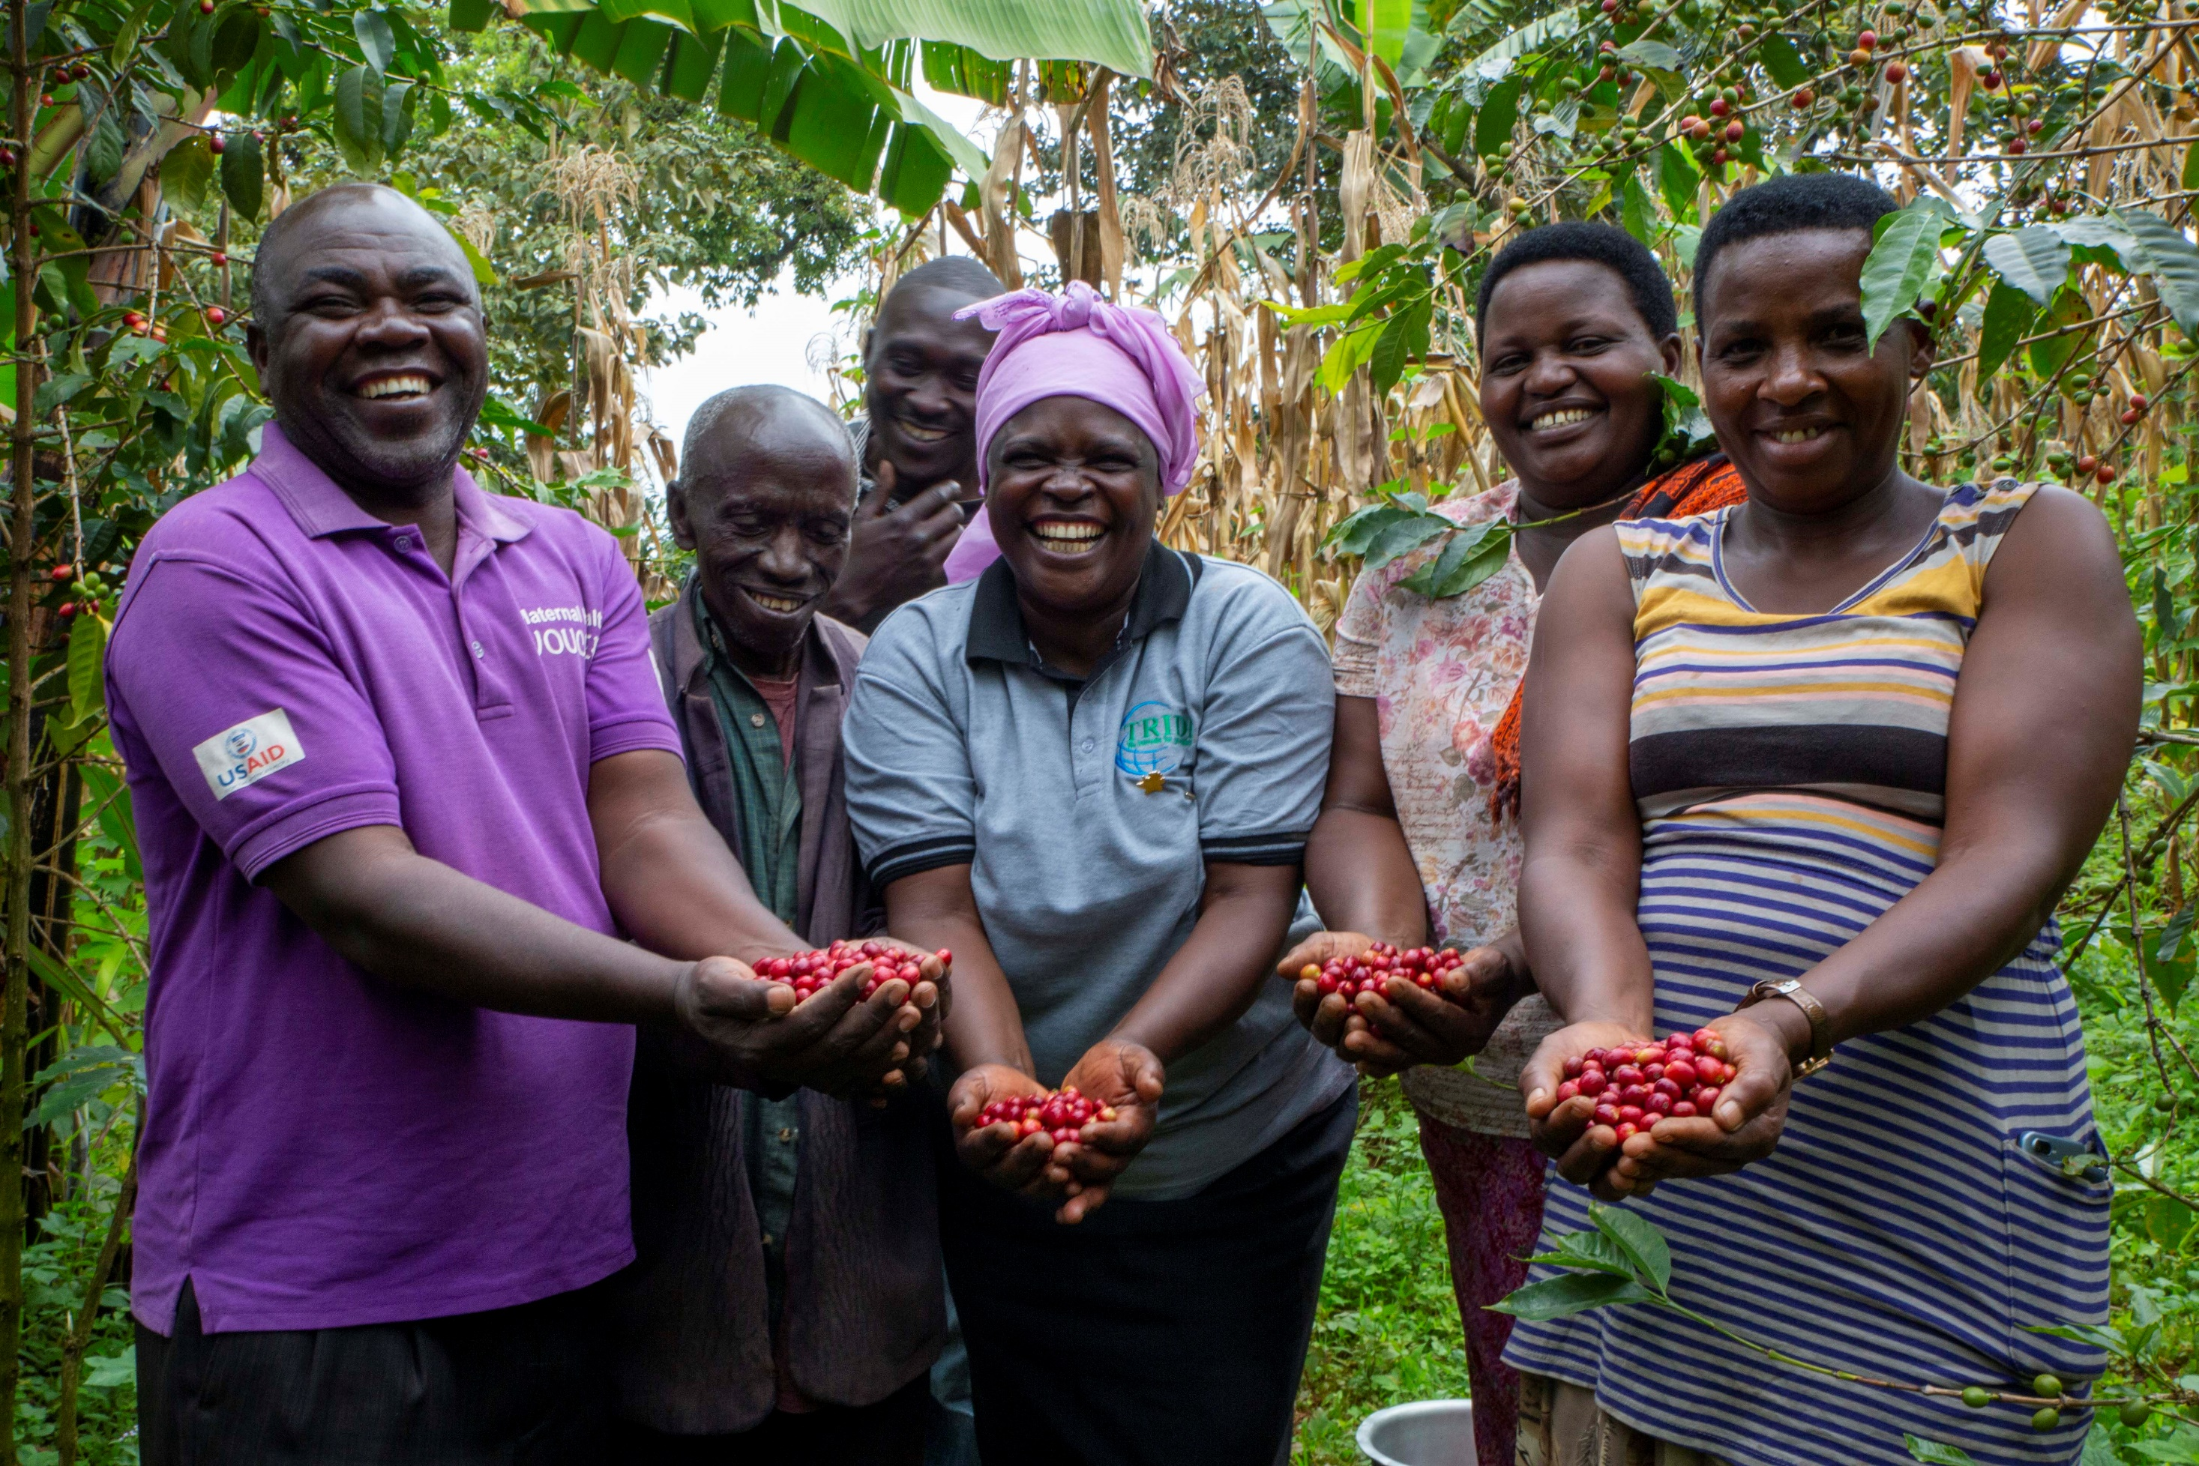
Listeners of the Farmers’ Voice Radio programmes in Mount Elgon, Uganda. Photo credit: Jenipher’s Coffi
Notes:
Picture of the Listeners of the radio programmes in Mount Elgon in Uganda

Slide 10
FARMERS’ VOICE RADIO ACADEMY
Putting the transformative power of participatory radio into the hands of millions more smallholder farmers
Training and mentoring programme
+
Online resources
+
Community of practice
+
Start up grants
We aim to train 20 farmer organisations per year, enabling Farmers’ Voice Radio programmes to reach 3 million smallholder producers in coffee growing regions
Notes:
Going forward, LYF would like to see more smallholder farmers and more supply chains benefiting from its FVR approach without LYF being directly involved in the implementation - essentially a kind of ‘open sourcing’.
In so doing, we have just launched the FVR Academy, which is providing a package of support (online training, mentoring, community of practice and start-up grant) for farmer groups, cooperatives and radio stations to enable them to set up their own Farmers Voice Radio programme series, in local language, that address the issues that matter most to the farmers in their communities.
So over the next 3 years we will train 20 farmer organisations to use the Farmers’ Voice Radio approach to raise the voices of coffee producers in their contexts. We estimate the programmes broadcast as a result of the training will reach 3 million smallholders per year living in coffee producing regions and connect them with the knowledge they need to tackle some of the most pressing challenges they are facing. This course will be free to the organisations who need it most BUT of course it isn’t free to deliver. It costs £30,000 per year to run the Farmers Voice Radio Academy- and we need your help!

Slide 11
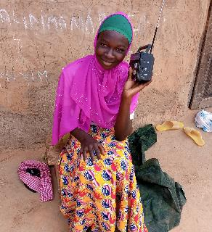
FARMERS’ VOICE RADIO ACADEMY
£25 is the cost of airtime for one 15-minute radio programme produced by an Academy graduate
£50 would cover the costs of one Farmers’ Voice Radio Academy training session and coaching per year
£100 is the cost of holding a farmer programme reference group meeting to record programme content
£1,500 is the cost of training one coffee producer organisation through the Farmers’ Voice Radio Academy
Notes:
So here’s our big call to action… We know you have an interest in supporting a sustainable coffee industry that puts smallholder producers at its centre. If you like what you’ve heard, please consider whether you or your business will support our FVR Academy and help to put the power of participatory radio into the hands of millions more farmers.
£25 is the cost of airtime for one 15-minute radio programme produced by an Academy graduate
£50 would cover the costs of one Farmers’ Voice Radio Academy training session and coaching per year
£100 is the cost of holding a farmer programme reference group meeting to record programme content
£1,500 is the cost of training one coffee producer organisation through the Farmers’ Voice Radio Academy

Slide 12
Scan here to sponsor Farmers’ Voice Radio Academy
Notes:
If you are a coffee roaster, or coffee shop, we want this partnership to benefit your business by creating opportunities to engage your suppliers, staff, clients and customers – so we offer a range of benefits to sponsors that we would love to discuss with you. But also, if you are an individual who simply loves a good cup of coffee, cares about where it comes from and would like to continue to enjoy this everyday luxury into the future, please consider supporting us.

Slide 13
Contact: Hannah Davis or Hannah Clark
Farmers’ Voice Radio Development Managers
Email: hdavis@lyf.org.uk / hclark@lyf.org.uk
Tel: +44 (0) 7966092264
Website: www.farmersvoiceradio.org
Farmers’ Voice Radio is an initiative of the Lorna Young Foundation (Charity No: 1112895)
Notes:
Please do get in touch if you would like any more information or to discuss partnership options. Mine and my colleague’s contact details are here- she is also called Hannah! Thank you very much for listening.

